Slide 1

SOCIAL MEDIA REACH Where Content Meets Influence
TEAM: Vyshnavi(TEAM LEAD)
:Vijay
:Keerthi
GUIDE :-Mahendra sir

Slide 2

Business Study of the Project
Correlation analysis between views, subscribers, and number of videos.
Category-based performance comparison.
Growth rate relative to creation date.
Identify top-performing niches or content types.
Factors:-
1) channel_id
2) channel_title
3) category
4) subscriber_count
5) view_count
6) video_count
7) created_at
8) channel_description
About us :-
To assess factors influencing YouTube reach and performance using metrics such as subscriber count, view count, video count, and content category.

Slide 3


Data Collection
This data was collected using YouTube API ,based on the features we required for this project was been extracted in this data.
Dataset Explanation:-
The dataset contains information about 1,530 YouTube channels, capturing key metrics related to their performance and reach.
Each entry includes the channel ID, title, content category, subscriber count, total view count, number of videos uploaded, channel creation date, and a description
Numerical features such as subscriber count, views, and video count provide quantitative measures of each channel's success, while category and creation date offer context for comparative and temporal analysis.

Slide 4
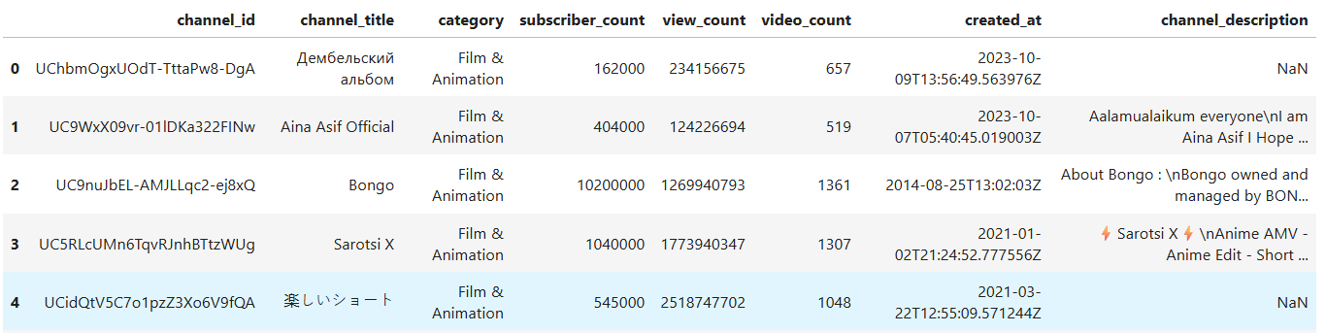
Top 5 rows

Slide 5
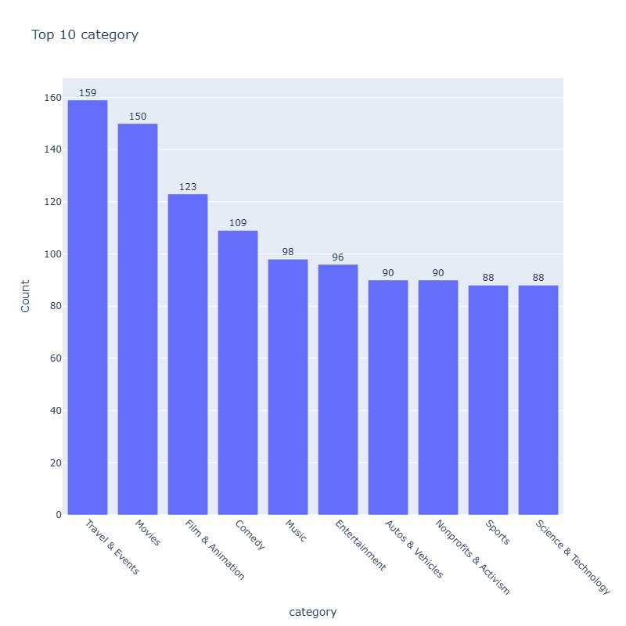
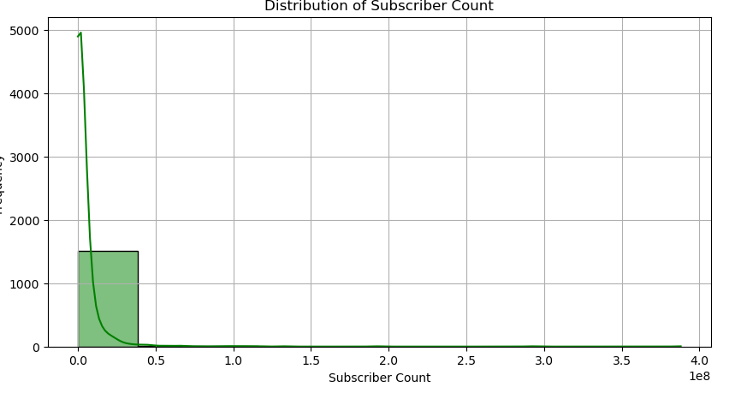
Uni-variate Analysis

Slide 6
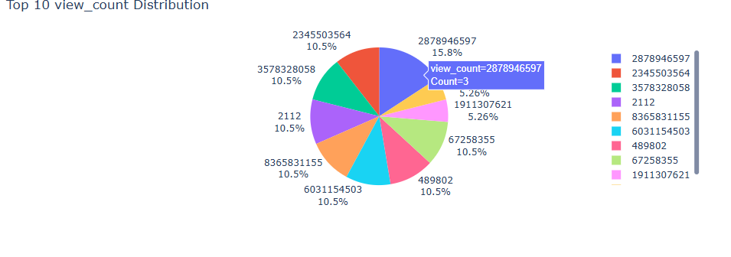

Slide 7
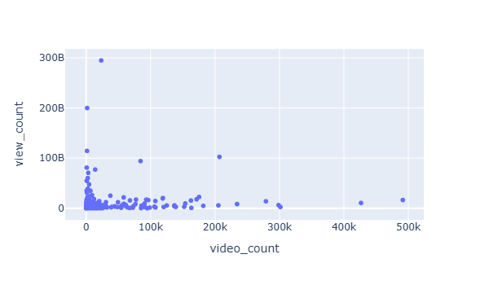
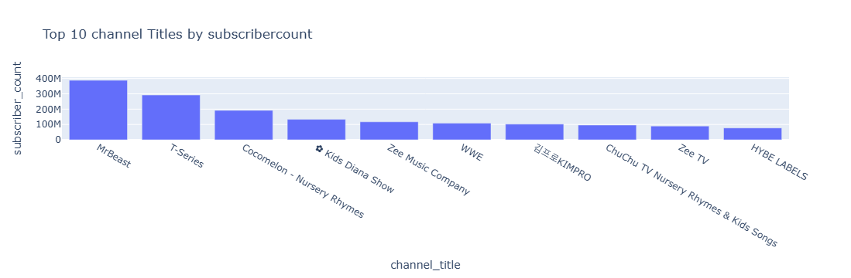
Bi-variate Analysis

Slide 8
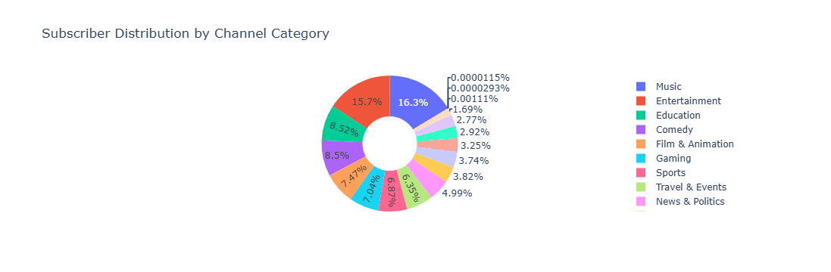

Slide 9
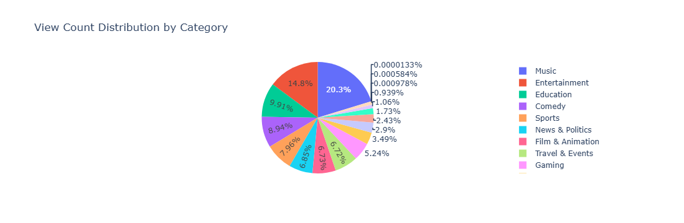

Slide 10
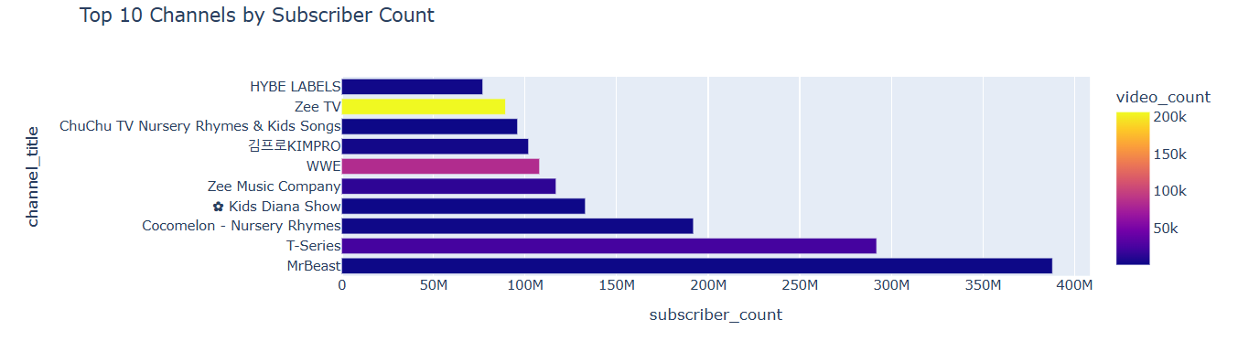
Multi-variate Analysis

Slide 11


Slide 12
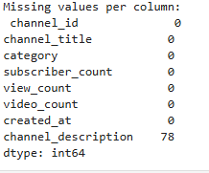
Filling Null Values

Slide 13
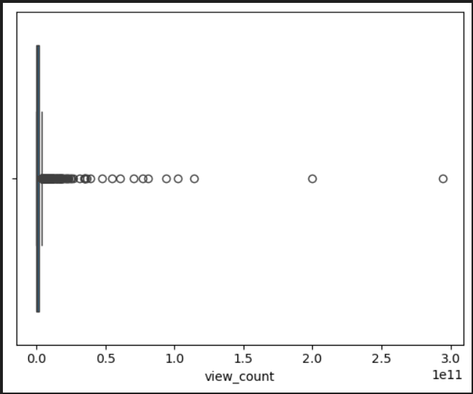
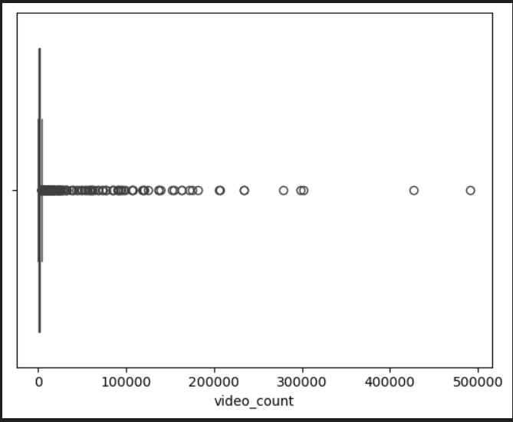
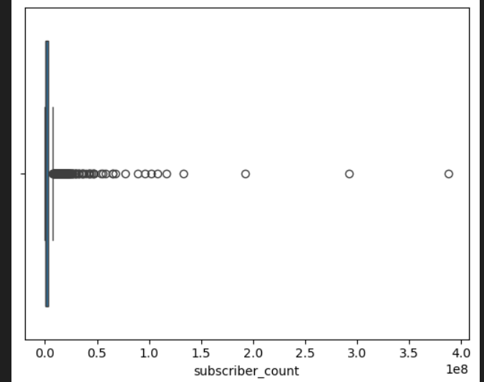
Handling Outliers

Slide 14
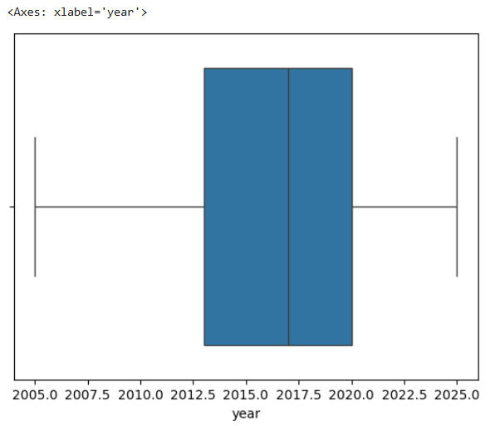
Handling Outliers

Slide 15
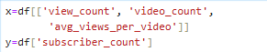
Predictive Modeling X and Y selection

Slide 16
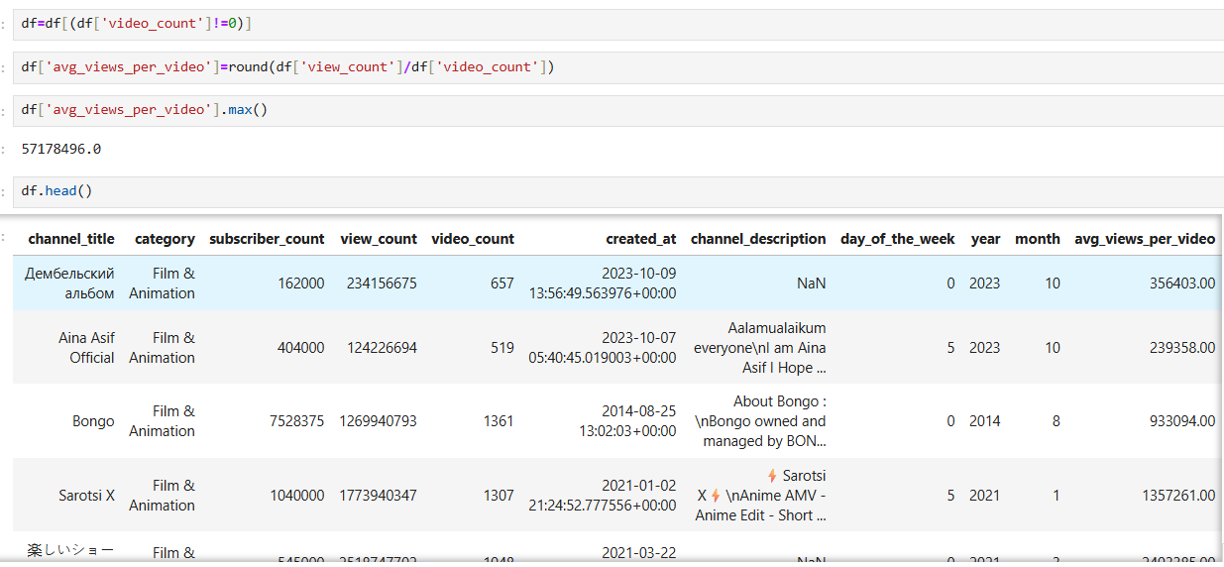
Feature Engineering

Slide 17
Train-Test Split

Slide 18

Model building

Slide 19
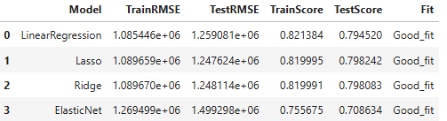
Training model with polynomial Features

Slide 20
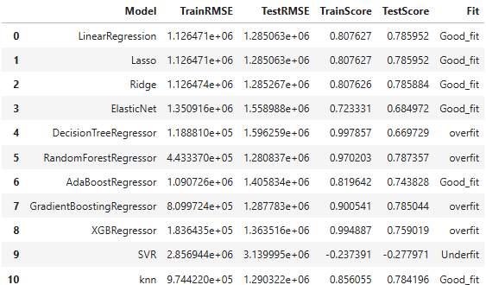
Without Polynomial Features

Slide 21
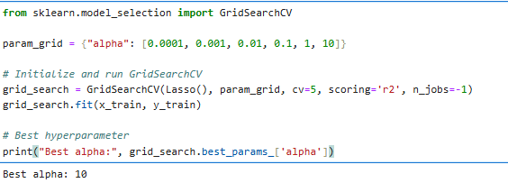
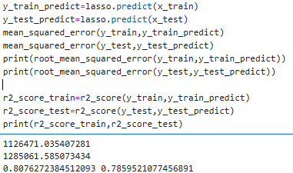
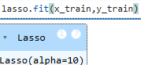
HyperParameterTuning

Slide 22
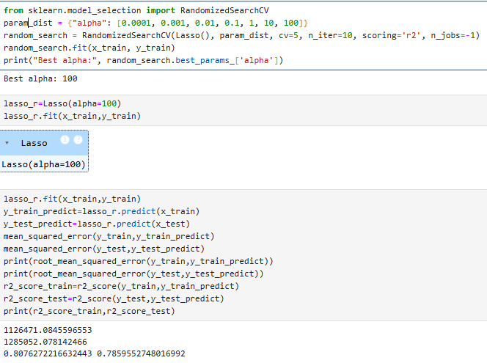

Slide 23
Best model
Best Model : Lasso
Metric | Value
Test RMSE | 1.247624e+06 (Lowest error)
Test Score | 0.798242 (Highest accuracy)
Fit | Good fit

Slide 24


